Slide 1
Sleeping Selkie Potions Store
Project 0 Presentation

Slide 2
Purpose of this Application
Makes acquiring potions easier and more efficient for the customer.
Allows users to order potions from their preferred store that they can then go pickup.

Slide 3
Technologies used in this App
Visual Studios- IDE, Compile, Create, Debug
EF Core - Implementing a database, manipulating tables
SqlLite Toolbox- View tables directly through out the development process
Github- Version Control System, used for storing various versions of the project during development.

Slide 4
Demo Application
Add New Customer
Set Preferred Store Location
LookUp existing customer
Change preferred store location
Add New order, Shows order details at end of order placement, New order rejects unreasonably high requests
Look up Customer Orders
Look up store orders

Slide 5
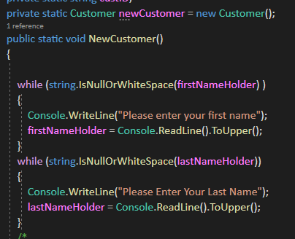
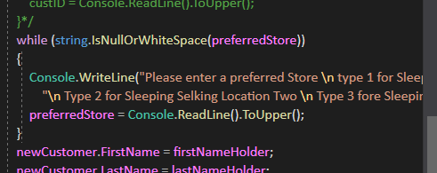
Input Validation
Used while loops and Is Null or white space
To make sure users entered something.

Slide 6
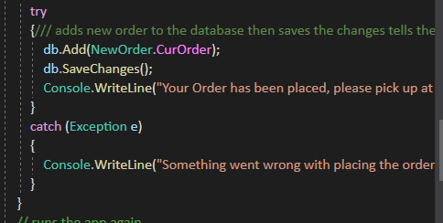
Exception Handling
Used Try Catch Blocks to
Handle thrown exceptions and
This was particularly useful while
Accessing or modifying database
data.

Slide 7
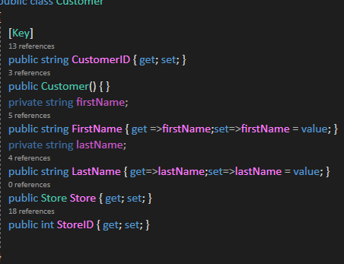
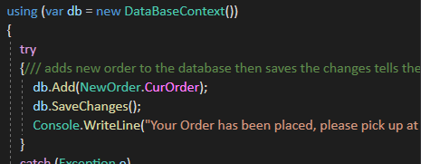
Persistent Data
Use Private fields, public properties and ef core to save data to a database, no hardcoded data.

Slide 8
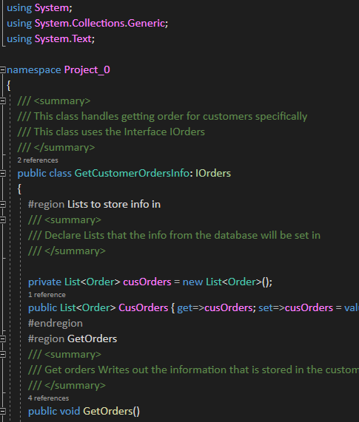
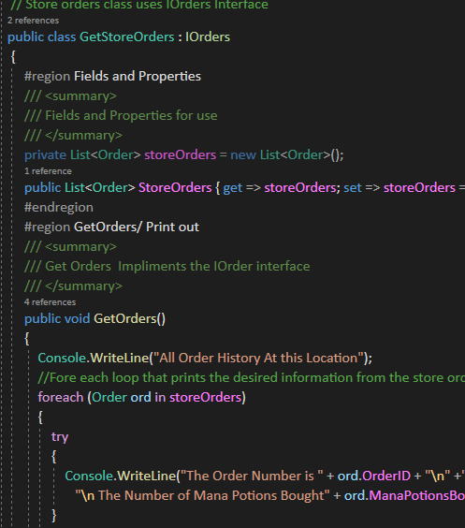
Interface

Slide 9
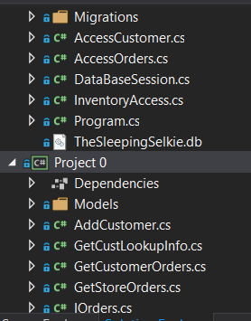
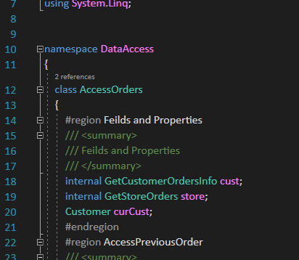
Data Access and Business Layer split

Slide 10
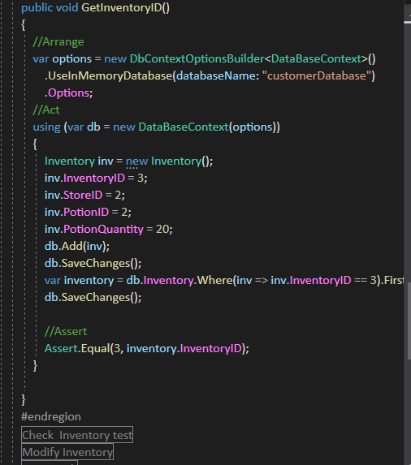
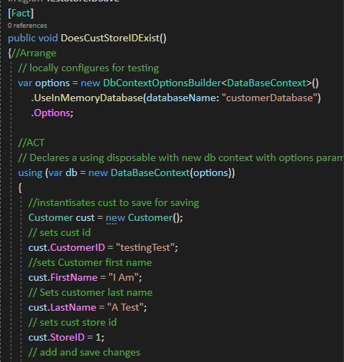
Test Methods

Slide 11
Conclusion
Whether you are a bard, mage, barbarian or cleric, this application streamlines the process of acquiring potions to heal or invigorate your party. There are still many improvements that will be made to this application, that will make it even more intuitive and useful.

